Slide 1


Slide 2




Slide 3



HASH SET
IN
JAVA

Slide 4
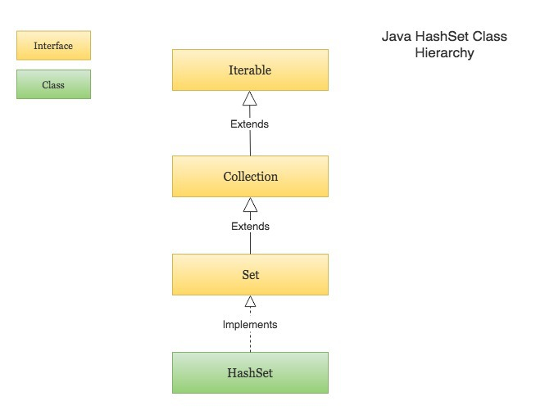
HASH-SET IN JAVA

Slide 5
HASH-SET IN JAVA
HashSet cannot contain duplicate values
HashSet allows null value
HashSet is an unordered collection
It does not maintain the order in which the elements are inserted
HashSet internally uses a HashMap to store its elements

Slide 6
CREATING AN HASHSET AND ADDING ELEMENTS
Set<String> daysOfWeek = new HashSet<>(); // Adding new elements to the HashSet daysOfWeek.add("Monday"); daysOfWeek.add("Tuesday"); daysOfWeek.add("Wednesday"); daysOfWeek.add("Thursday"); daysOfWeek.add("Friday"); daysOfWeek.add("Saturday"); daysOfWeek.add("Sunday"); // Adding duplicate elements will be ignored daysOfWeek.add("Monday");
Notes:
Output:
[Monday, Thursday, Friday, Sunday, Wednesday, Tuesday, Saturday]

Slide 7
CONSTRUCTORS IN HASHSET
HashSet() | Constructs a new, empty set; the backing HashMap instance has default initial capacity (16) and load factor (0.75)
HashSet(Collection<? extends E> c) | Constructs a new set containing the elements in the specified collection
HashSet(int initialCapacity) | Constructs a new, empty set; the backing HashMap instance has the specified initial capacity and default load factor (0.75)

Slide 8
METHODS IN HASHSET

Slide 9
isEmpty
public boolean isEmpty()
Returns true if this set contains no elements.
Returns:
true if this set contains no elements

Slide 10
LOGIC
import java.util.HashSet; import java.util.Set; public class HashSetSimpleOperationsExample { public static void main(String[] args) { Set<String> popularCities = new HashSet<>(); // Check if a HashSet is empty System.out.println("Is popularCities set empty? : " + popularCities.isEmpty());
Notes:
# Output :
Is popularCities set empty? : true

Slide 11
SIZE
public int size()
Returns the number of elements in this set (its cardinality)
Returns: the number of elements in this set (its cardinality)

Slide 12
LOGIC
Set<String> popularCities = new HashSet<>(); popularCities.add("London"); popularCities.add("New York"); popularCities.add("Paris"); popularCities.add("Dubai"); // Find the size of a HashSet System.out.println("Number of cities in the HashSet " + popularCities.size());
Notes:
OUTPUT :
Number of cities in the HashSet 4

Slide 13
contains
public boolean contains(Object o)
Returns true if this set contains the specified element. More formally, returns true if and only if this set contains an element e such that (o==null ? e==null : o.equals(e)).
Parameters: o - element whose presence in this set is to be tested
Returns: true if this set contains the specified element

Slide 14
LOGIC
Set<String> popularCities = new HashSet<>(); popularCities.add("London"); popularCities.add("New York"); popularCities.add("Paris"); popularCities.add("Dubai"); String cityName = "Paris"; if(popularCities.contains(cityName)) System.out.println(cityName + " is in the popular cities set."); else System.out.println(cityName + " is not in the popular cities set.");
Notes:
OUTPUT:
Paris is in the popular cities set.

Slide 15
REMOVING ELEMENTS FROM HASH SET
The following program consist of:
Remove an element from a HashSet.
Remove all the elements that exist in a given collection from the HashSet.
Remove all the elements that satisfy a given predicate from the HashSet.
Clear the HashSet completely by removing all the elements
Notes:
OUTPUT:
Paris is in the popular cities set.

Slide 16
EXAMPLE:
import java.util.ArrayList; import java.util.HashSet; import java.util.List; import java.util.Set; public class HashSetRemoveExample { public static void main(String[] args) { Set<Integer> numbers = new HashSet<>(); numbers.add(2); numbers.add(3); numbers.add(4); numbers.add(5); numbers.add(6); numbers.add(7); numbers.add(8); numbers.add(9); numbers.add(10);
Notes:
OUTPUT:
Paris is in the popular cities set.

Slide 17
CONTINUED….
// Remove an element from a HashSet (The remove() method returns false if the element does not exist in the HashSet) boolean isRemoved = numbers.remove(10); System.out.println("After remove(10) => " + numbers); // Remove all elements belonging to a given collection from a HashSet List<Integer> perfectSquares = new ArrayList<>(); perfectSquares.add(4); perfectSquares.add(9); numbers.removeAll(perfectSquares);

Slide 18
CONTINUED..
numbers.removeAll(perfectSquares); System.out.println("After removeAll(perfectSquares) => " + numbers); // Remove all elements matching a given predicate numbers.removeIf(num -> num % 2 == 0); System.out.println("After removeIf() => " + numbers); // Remove all elements from HashSet (clear it completely) numbers.clear(); System.out.println("After clear() => " + numbers); } }
Notes:
# Output
numbers : [2, 3, 4, 5, 6, 7, 8, 9, 10]
After remove(10) => [2, 3, 4, 5, 6, 7, 8, 9]
After removeAll(perfectSquares) => [2, 3, 5, 6, 7, 8]
After removeIf() => [3, 5, 7]
After clear() => []

Slide 19

THANK YOU

